Slide 1
Feedback for the Everstream Group
MET 431/531
By Tyson Stewart, Landon Moeller, Owen Cutinello, and Matthew Woods

Slide 2
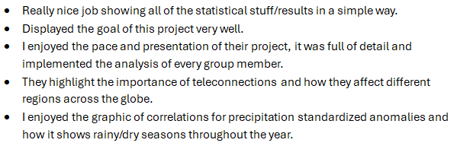
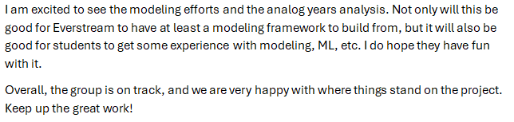
General Feedback
Feedback was overall very positive
Initial results were well received
Seems like we are overall on track and doing what we need to do
Will continue to check in with Everstream to make sure our work continues to fufill their needs

Slide 3
Areas of Improvement

Slide 4
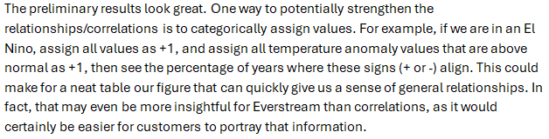
Improvements To Figures
Annotations were suggested to help make findings from some of the figures more clear to the reader
For the presentation, avoiding repeating information when presenting figures
No need to mention what each axis is showing if they are already well labeled
Potentially explore categorizing values

Slide 5
Improvements To Writing/Report
Suggestion of improving discussion on the study areas
Answering the questions of "Why do these regions matter? and "What sectors are more at play in this region compared to others?"
More work is needed on balancing detail and conciseness
Feedback from Everstream: "The challenge with examining 13 regions across 20+ teleconnections is how to synthesize all of this information into a single report. Really take some time to think about how to hammer home the key points without getting too much into the weeds."
Also, important that we avoid repeating information/phrasing when discussing the same data but in different regions

Slide 6
Outlook on future Work

Slide 7
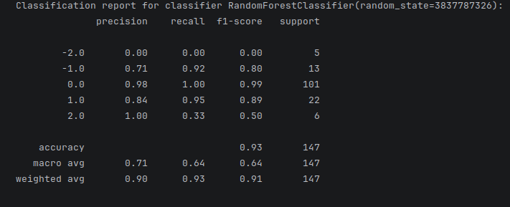
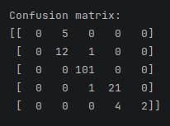
Outlook on future work
Proposed future work was received very positively
There seems to be quite a bit of enthusiasm towards an additional ML model as well as the proxy years product
Work is currently being done in addition to the statistical model to be able to provide those additional products

Slide 8
Outlook on future work
Everstream partners suggested using detrended climate anomaly data from ERA5
Goal of first determining whether there is a notable difference from the original data
Logan has provided us with this data
Need to put this data into the same .nc format as before so we can rerun our scripts to do a broad check for differences
Multi-linear regression model still needs to be built

Slide 9
Project Schedule Check-in

Slide 10
Project Schedule
Everstream/Teleconnections Group Work Plan
Milestones | 9-Feb | 16-Feb | 23-Feb | 2-Mar | 9-Mar | 16-Mar | 23-Mar | 30-Mar | 6-Apr | 13-Apr | 20-Apr | 27-Apr | 4-May
Define/Finalize Objectives |  |  |  |  |  |  | Midterm Report Due |  |  |  | Final Report/Presentations
Determine Methodology/Process
Data Processing
Data Analysis/Programming Work
Midterm Report Writing
Feedback/Revision
Final Report Writing

Slide 11
goals contract check-in

Slide 12
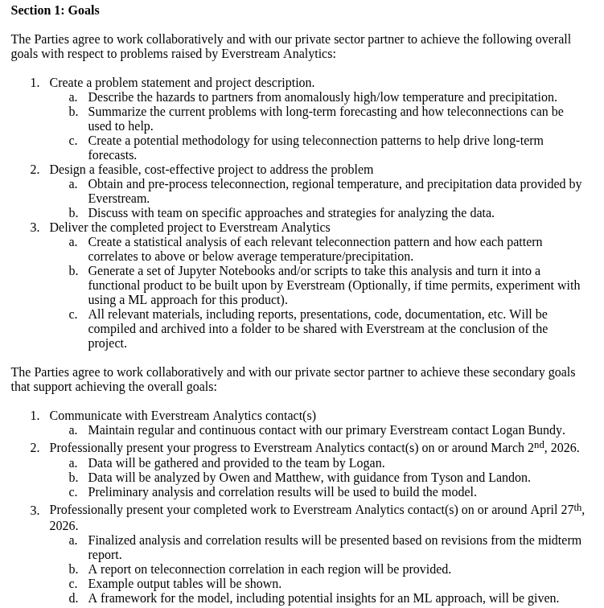
Complete
Complete
In-Progress
Complete
Complete
In-Progress

